Slide 1
Thermal & Marine Pollution

Slide 2


Thermal Pollution is the harmful increase in water temperature in streams, rivers, lakes, or occasionally, coastal ocean waters.
It is the degradation of water quality by any process that changes ambient water temperature.
A temperature increase as small as 1 or 2 Celsius degrees (about 2 to 4 Fahrenheit degrees) can kill native fish, shellfish, and plants, often with undesirable effects.

Slide 3
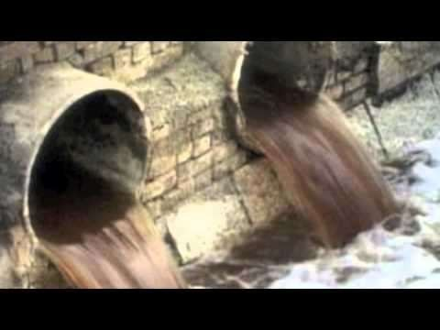
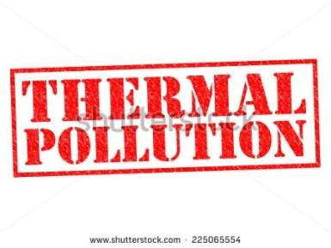
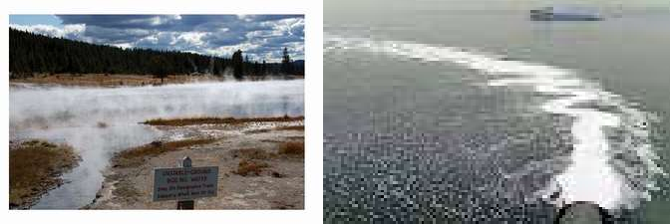

Slide 4
The major sources of thermal pollution
Nuclear power plant
Industrial effluents
Domestic sewage
Coal fired power plants
Deforestation
Soil erosion

Slide 5



Nuclear power plants use water as a cooling agent.
After the water is used, it is put back into a water supply at 9-20ºC warmer .
Emission from nuclear reactors increase the temperature of water bodies.

Slide 6


Coal is utilized as a fuel.
Condenser coils are cooled with water from nearby lake or river.
The heated effluents decrease the DO of water.
Damages the marine organisms.

Slide 7
Discharged water from steam-electric power industry using turbo generators will have a higher temperature ranging from 6 to 9˚C.
In modern stations, producing 100 MW, nearly one million gallons are discharged in an hour with increase in temperature of the cooling water passing by 8 to 10 ˚C .

Slide 8

Sewage is commonly discharged into lakes, canals or streams.
Municipal sewage normally has a higher temperature.
Increase in temperature of the receiving water decreases the dissolved oxygen of water.
The foul smelling gases increased in water resulting in death of marine organisms.

Slide 9

Streams and small lakes are naturally kept cool by trees and other tall plants that block sunlight.
People often remove this shading vegetation in order to harvest the wood in the trees, to make room for crops, or to construct buildings, roads, and other structures.

Slide 10

Removal of vegetation far away from a stream or lake can contribute to thermal pollution by speeding up the erosion of soil into the water, making it muddy, which increases the light absorbed .

Slide 11


Elevated temperature typically decreases the level of dissolved oxygen of water.
Increases the metabolic rate of aquatic animals, as enzyme activity, resulting in these organisms consuming more food in a shorter time, which increases their need for oxygen.
High temperature limits oxygen dispersion into deeper waters, contributing to anaerobic conditions.

Slide 12
Many aquatic species will fail to reproduce at elevated temperatures.
Primary producers are affected by warm water because higher water temperature increases plant growth rates, resulting in a shorter lifespan and species overpopulation.

Slide 13
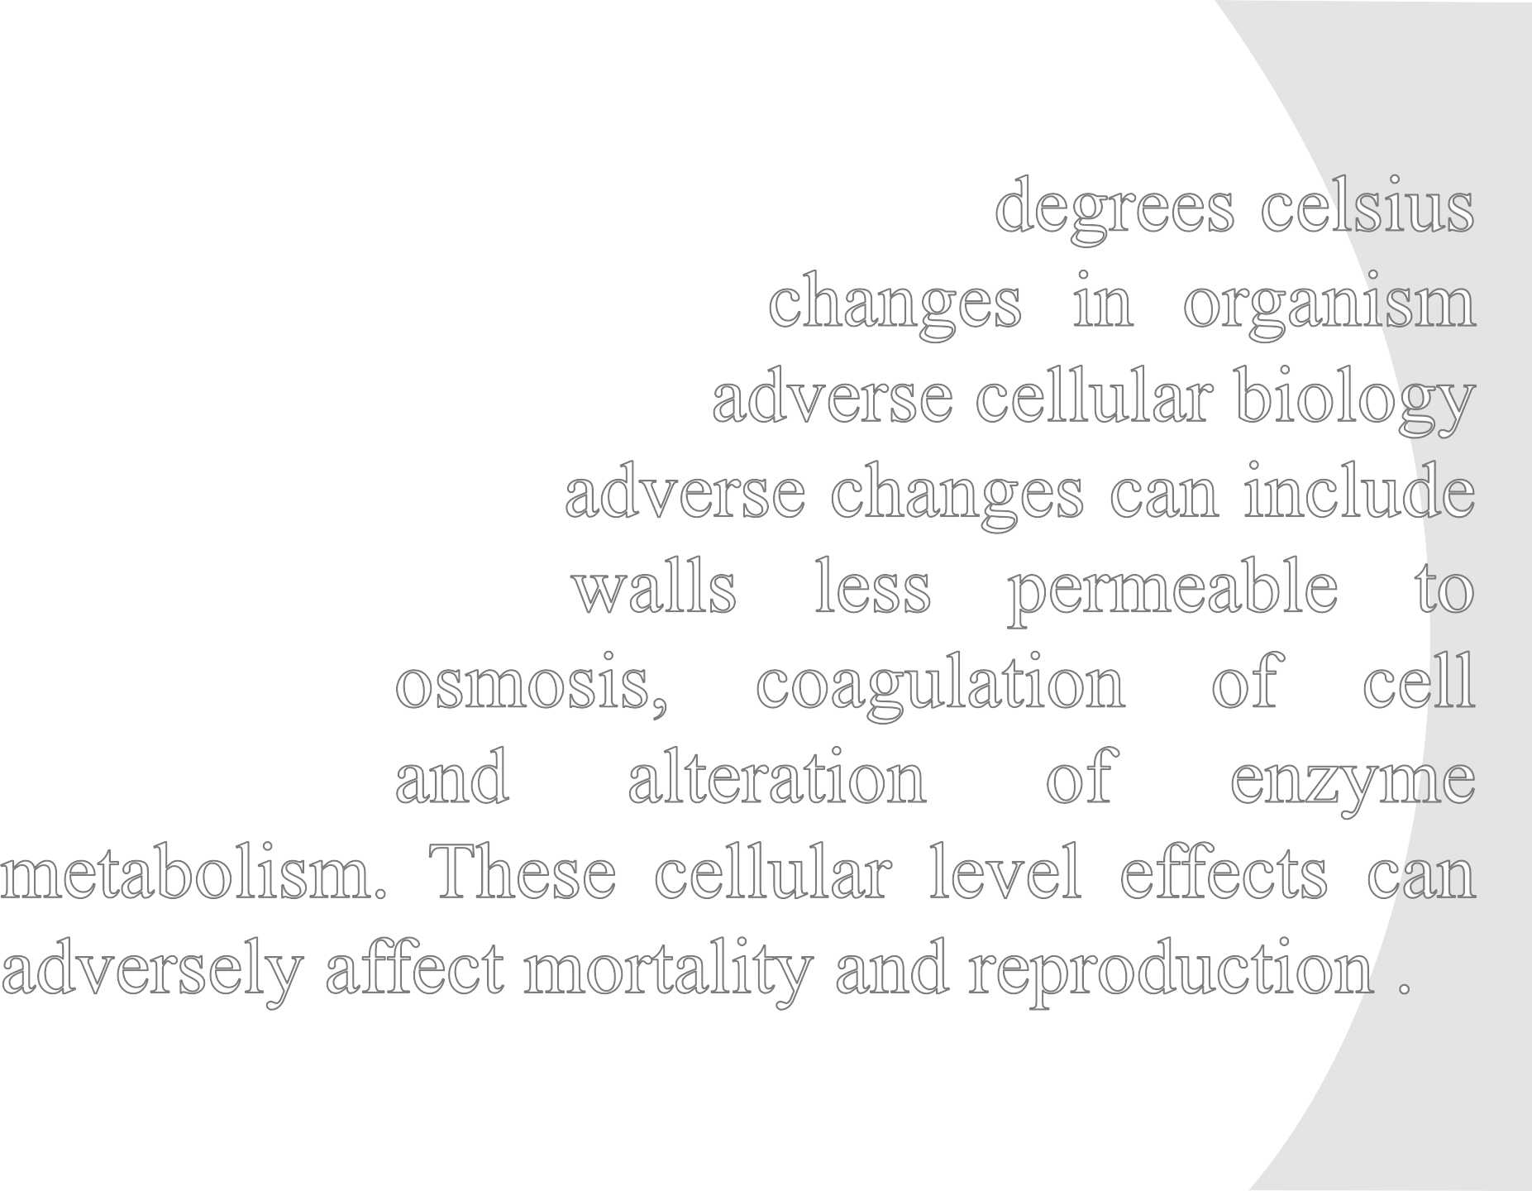


















Slide 14
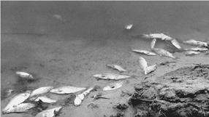
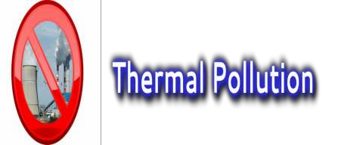
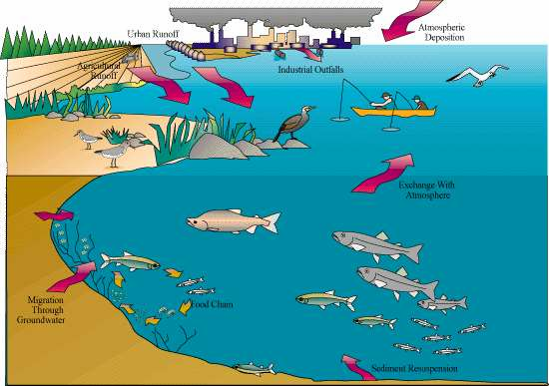

Slide 15

Use less electricity
Use of Better Technologies
Less nuclear power
Plantation of more trees upon the banks of rivers, seas & other water bodies
Recycling used water
Cooling towers - process it by transferring its heat and transform hot water into cold water. This cool water can be recycles and used again for different industrial purposes.
Spreading awareness among people

Slide 16
Marine Pollution

Slide 17
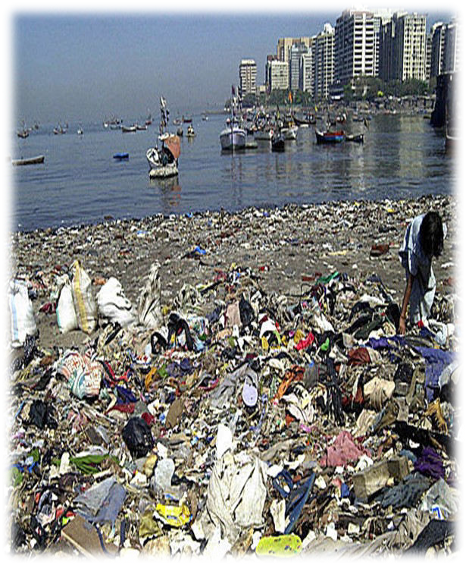
What is Marine Pollution ??
Marine pollution occurs when harmful, or potentially harmful, effects result from the entry into the ocean of chemicals, particles, industrial, agricultural, and residential waste, noise, or the spread of invasive organisms.
Eighty percent of marine pollution comes from land.
The pollution often comes from nonpoint sources such as agricultural runoff, wind-blown debris, and dust.

Slide 18
Ways of Pollutant Inputs
There are five main types of inputs of pollution into the ocean
❑ Direct discharge of waste into the oceans,
❑ Runoff into the waters due to rain
❑ Ship Pollution
❑ Atmospheric Pollution
❑ Deep Sea Mining
6

Slide 19
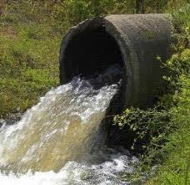
Direct Discharge
•
Pollutants enter rivers and the sea directly
from urban sewerage and industrial waste discharges, sometimes in the form of hazardous and toxic wastes
•
Inland mining for copper, gold. etc., is another source of marine pollution.
Most of the pollution is simply soil, which ends up in rivers flowing to the sea.
•
•

Slide 20
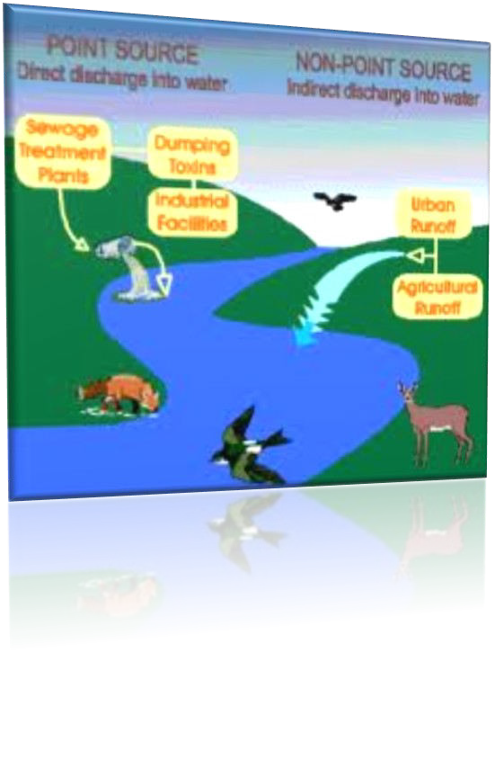
Surface Run-off
•
Surface runoff from farming, as well as urban runoff and runoff from the construction of roads, buildings, ports, channels, and harbours, can carry soil and particles laden with carbon, nitrogen, phosphorus, and minerals.
This nutrient-rich water can cause fleshy algae and phytoplankton to thrive in coastal areas, known as algal blooms, which have the potential to create anaerobic conditions by using all available oxygen
•

Slide 21
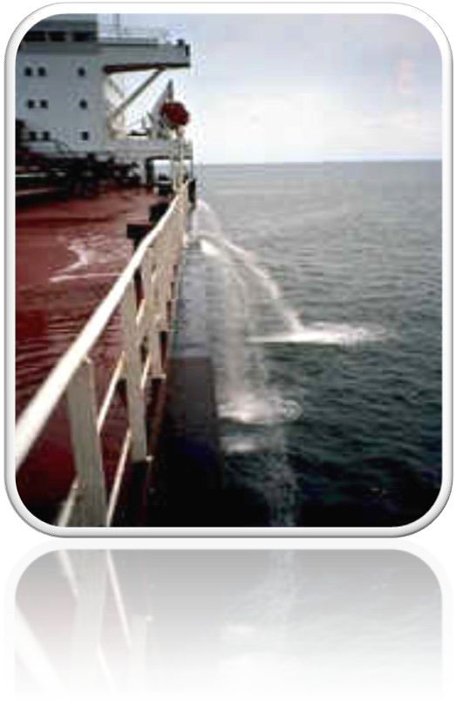
Ship’s pollution
Ships can pollute waterways and oceans in many ways:
•Oil spills can have devastating effects. While being toxic to marine life, polycyclic aromatic hydrocarbons (PAHs), the components in crude oil, are very difficult to clean up, and last for years in the sediment and marine environment.
•Discharge of cargo residues from bulk carriers can pollute ports, waterways and oceans
•It has been estimated that container ships lose over 10,000 containers at sea each year (usually during storms).
•Ships also create noise pollution that disturbs natural wildlife

Slide 22
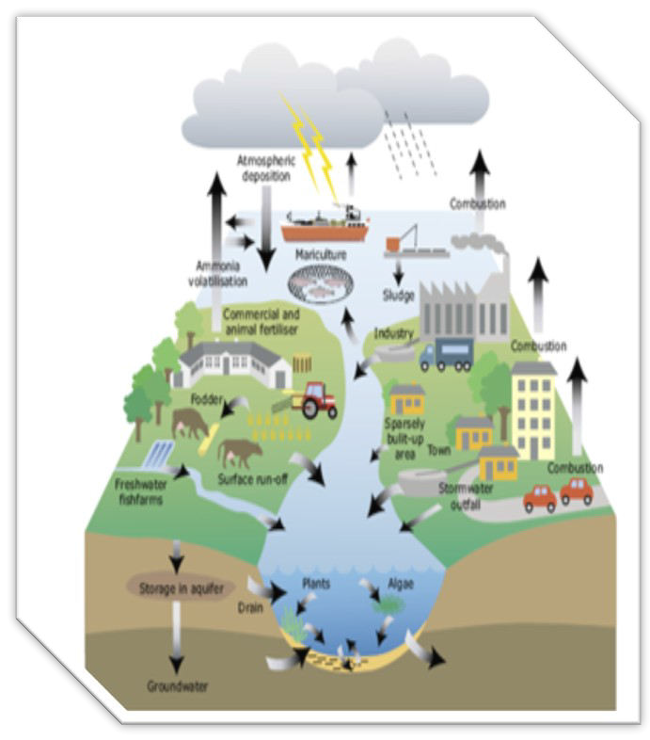
Atmospheric pollution
Wind blown dust and debris, including plastic bags, are blown seaward from landfills and other areas.
Climate change is raising ocean temperatures and raising levels of carbon dioxide in the atmosphere.
These rising levels of carbon dioxide are acidifying the oceans.

Slide 23
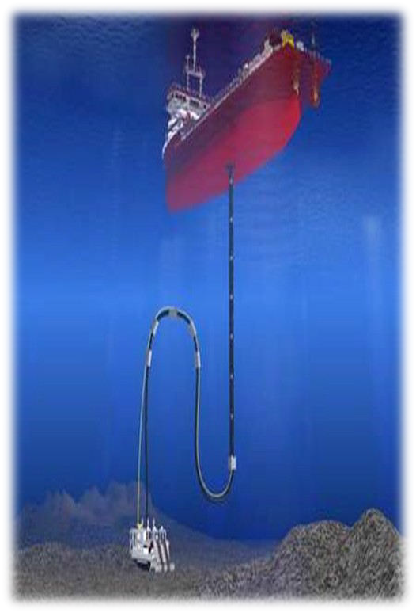
Deep Sea Mining
Deep sea mining is a relatively new mineral retrieval process that takes place on the ocean floor.
1,400 – 3,700 meters below the ocean's surface.
The vents create sulfide deposits, which contain precious metals such as silver, gold, copper, manganese, cobalt, and zinc.
The deposits are mined using either hydraulic pumps or bucket systems that take ore to the surface to be processed.
Removing parts of the sea floor disturbs the habitat of benthic organisms, possibly, depending on the type of mining and location, causing permanent disturbances.
Aside from direct impact of mining the area, leakage, spills are also part of marine pollution
11

Slide 24
Effects of Marine Pollution
Effect of Toxic Wastes on Marine Animals
Oil spill is dangerous to marine life in several ways.
The oil spilled in the ocean could get on to the gills and feathers of marine animals, which makes it difficult for them to move or fly properly or feed their children.
The long term effect on marine life can include cancer, failure in the reproductive system, behavioral changes, and even death.

Slide 25
Disruption to the Cycle of phytoplanktons
Oil spill floats on the surface of water and prevents sunlight from reaching to marine plants and affects in the process of photosynthesis.
Skin irritation, eye irritation, lung and liver problems can impact marine life over long period of time.

Slide 26
Depletes Oxygen Content in Water
Most of the debris in the ocean does not decompose and remain in the ocean for years.
It uses oxygen as it degrades. As a result of this, oxygen levels go down.
When oxygen levels go down, the chances of survival of marine animals like whales, turtles, sharks, dolphins, penguins for long time also goes down.

Slide 27
Effect on Food Chain
Chemicals used in industries and agriculture get washed into the rivers and from there are carried into the oceans.
These chemicals do not get dissolved and sink at the bottom of the ocean.
Small animals ingest these chemicals and are later eaten by large animals, which then affects the whole food chain.

Slide 28
Affects Human Health
Animals from impacted food chain are then eaten by humans which affects their health as toxins from these contaminated animals gets deposited in the tissues of people and can lead to cancer, birth defects or long term health problems.

Slide 29
Control
Toxic pollutants from industries and sewage treatment plants should not be discharged in coastal waters.
Run off from non-point sources should be prevented to reach coastal areas.
Dumping of toxic, hazardous wastes and sewage sludge should be banned.
Developmental activities on coastal areas should be minimized.
Oil and grease from service stations should be processed for reuse.
Ecologically sensitive coastal areas should be protected by not allowing drilling and mining.

